Slide 1

British Airways Customer Bookings
Ajay Iyer
December 7 2022

Slide 2
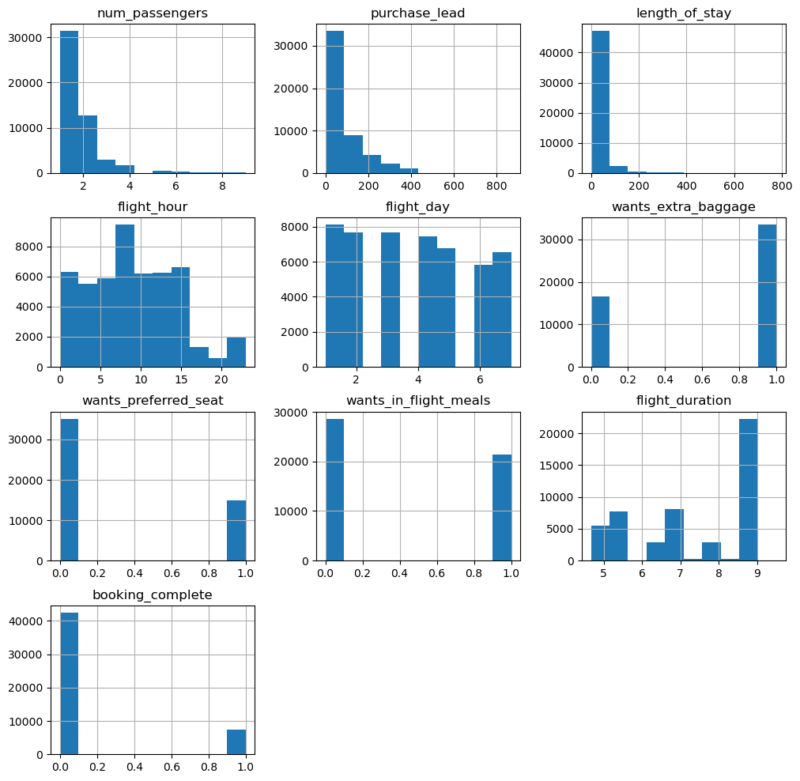
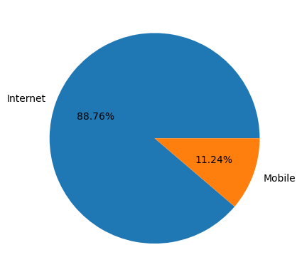
Results
89 % of bookings are made thru Internet
Round Trip bookings are sold significantly more than another type
Australia, Malaysia, South Korea, Japan, and China are where bookings were made mostly
Random Forest Classification Model
Accuracy 85%
Precision 85%
Recall 100
F1-Score 0.92

